Slide 1
BCU industry standard facilities and equipment
Martin Weston

Slide 2
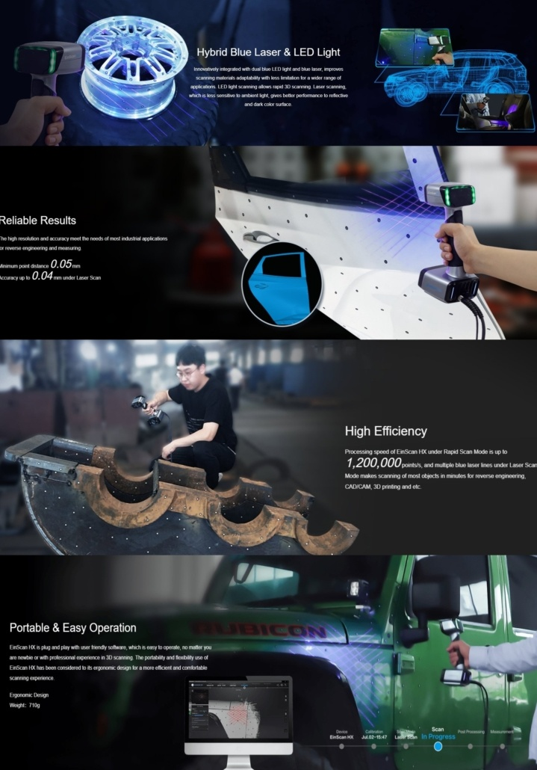
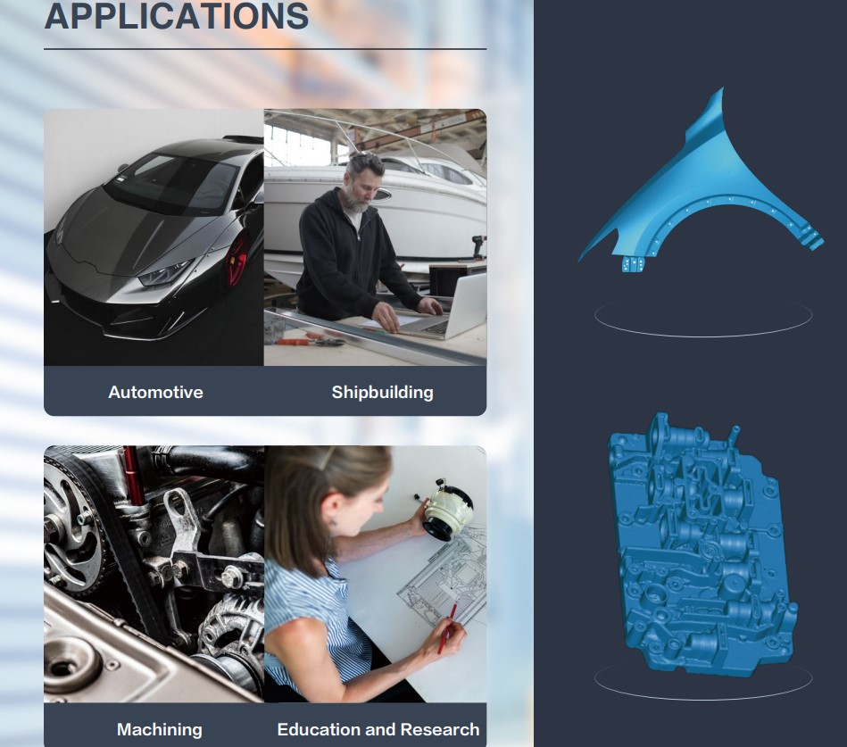
3D Scanner
Bridging the gap between 3D scanning and CAD for applications:
Reverse Engineering
Convergent modelling
Synchronous modelling
Simulation
Generative design
Additive manufacturing

Slide 3
Transforming digital design to reality-
Additive Manufacturing (3D printing)
Produce complex, intricate shapes and geometries for one offs, prototypes and short runs to industry standard.
Opening up new design possibilities across a multitude of applications, including: aerospace, biomedical, automotive, tooling and research, etc.

Slide 4
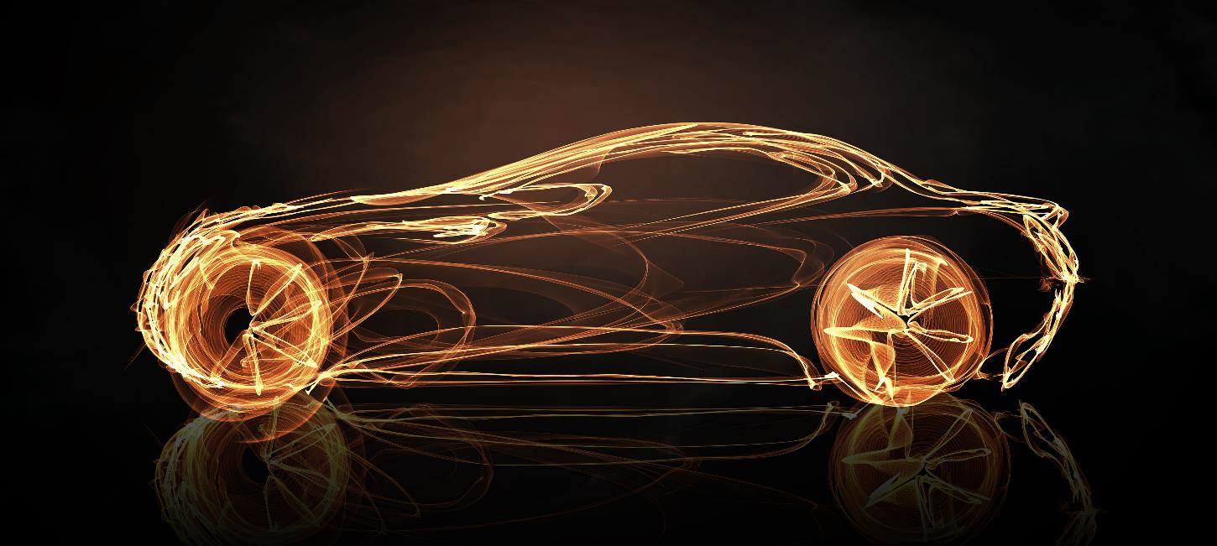
Advancing automotive technologies from IC to EV

Slide 5
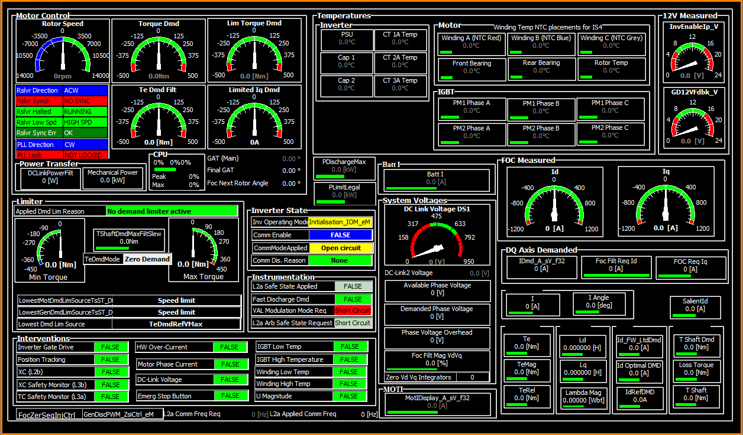
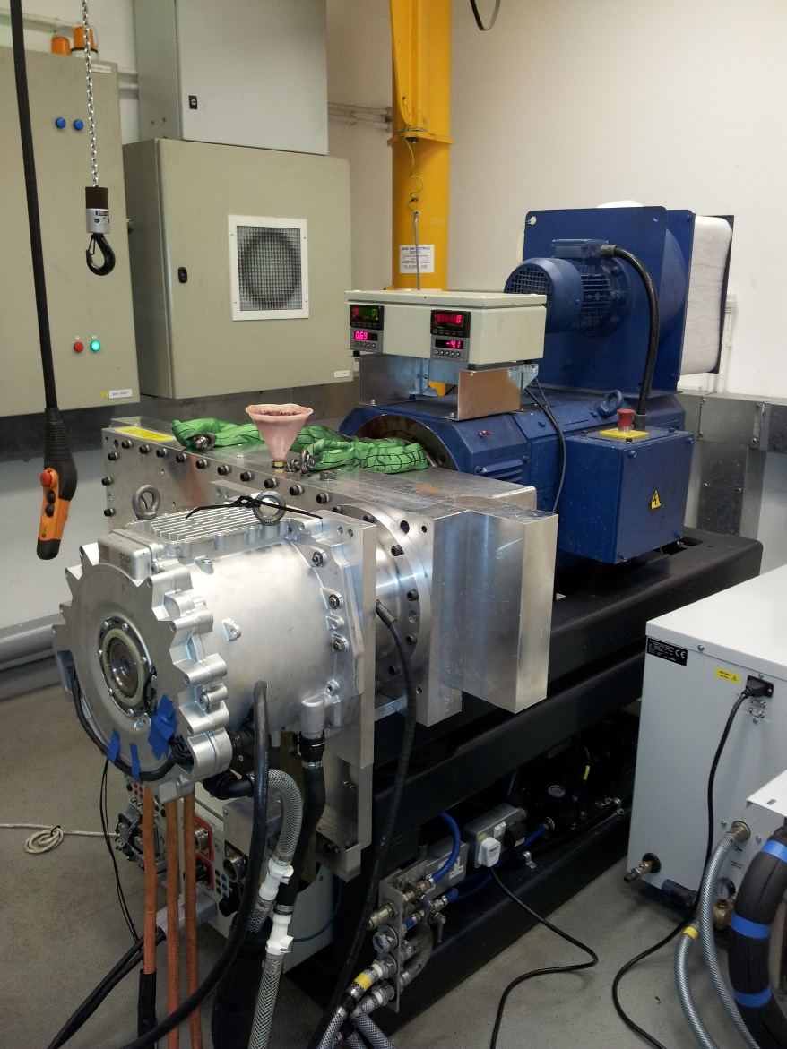
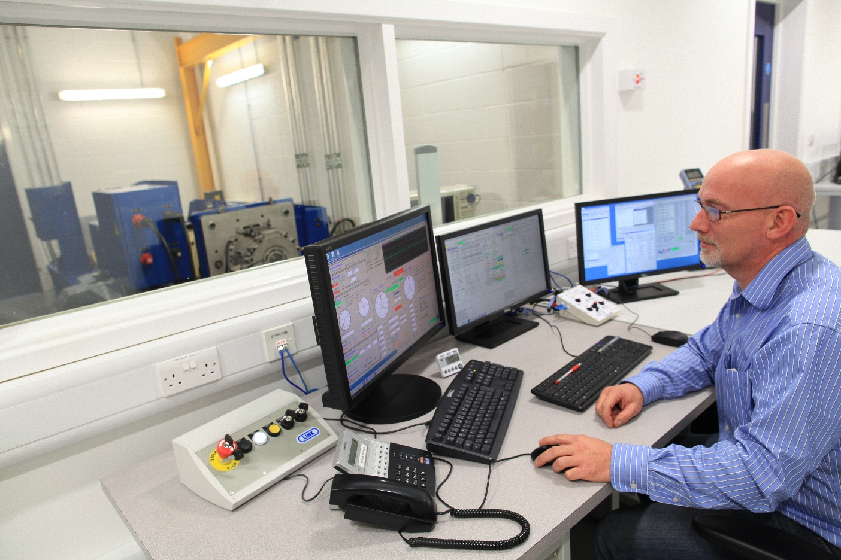
Electric Vehicle (EV) Test Rig
The EV test rig enables the latest industry technologies to provide advancements in skills, research, design, development and production including understanding and application of:
machine equipment digital control systems
System and component testing Identifying and analysing performance data for verification against automotive industry specifications and regulations.

Slide 6
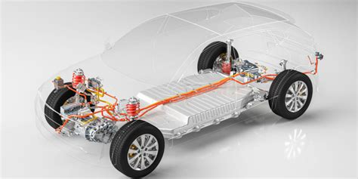
Electric Vehicle (EV) Test Rig
The BCU test rig is able to test the EV motor, gearbox, connectors and invertor in order to reduce:
Mass
Weight
Costs
Lead times
and enhance critical safety
Achieving automotive industry standards

Slide 7
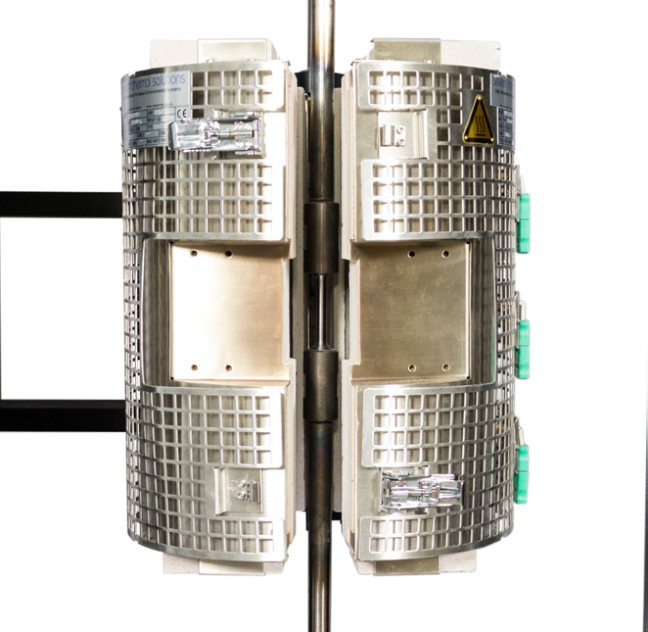
Material testing-split zone furnace
The testing System provides up to 100 kN (22,500 lbf) Force Capacity and 1200 °C with variable temperature control, on products and materials:
Tensile
Compression
Bend tests
Simulating working conditions pre-production to advance materials and component properties verification reducing product failure and recall.

Slide 8
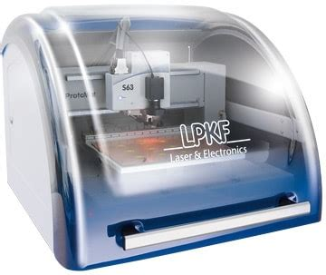
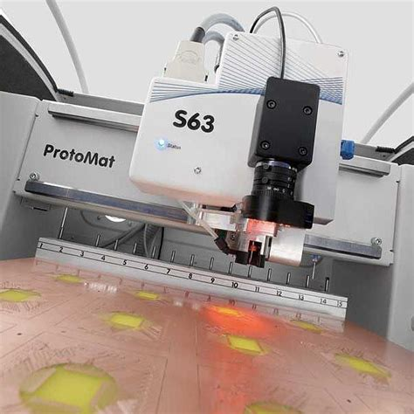
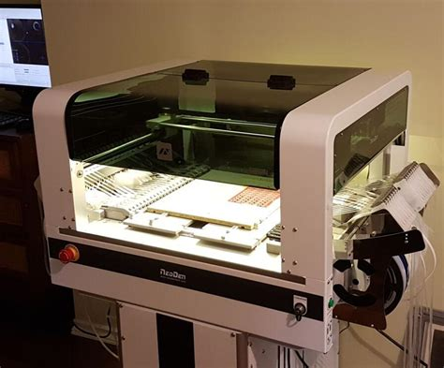
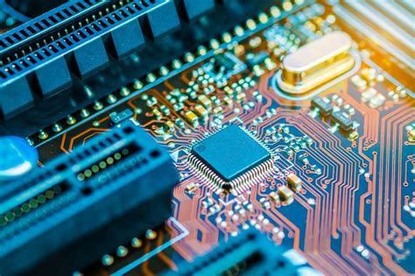
Electronics- Prototyping and production line
Streamlined PCB prototyping and manufacture reducing cycle times for your design to product through:
Circuit board printing, milling, drilling and engraving.
Pick and place ‘surface mount technology (SMT), rapidly positioning components.
Reflow oven one touch soldering

